Slide 1
Fin BluePrint: Financial Products Overview
VISHAL DALAL – Certified Financial Planner [CFP^{CM}]

Slide 2

Contents
Types of Asset Classes / Products
Asset Allocation based on goals, time horizon & risk

Slide 3
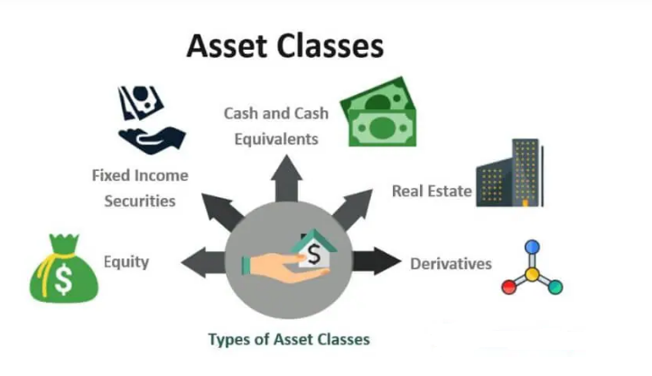

Slide 4
Asset Classes & Products - Debt
Product | Liquidity | Risk | Suitable For | Taxation
Bank Fixed Deposits | H | L | ST | Clubbed with income
Corporate Bonds AAA, AA, Credit-Risk | L | L / M / H Per Ratings & Duration | ST, MT | Clubbed with income
Small Saving Schemes NSC/KVP/PPF/Post-Office | L | L | MT, LT | 80C benefits, EET, EEE
Gov / Mun / RBI Bonds | L | L | MT, LT | Clubbed with income
Mutual Fund Debt, Dynamic Bond, Corp Bond | H | L / M / H (Per mandate) | LT | Capital Gains*, LT: 20%** ST: Clubbed
ST / MT / LT: Short-Term (<3 yrs) / Medium-Term (3 – 7 yrs) / Long-Term (> 7 yrs)
L / M / H: Low / Medium / High
* Long Term is greater than 3 years
** With Indexation

Slide 5
Asset Classes & Products - Equity
Product | Liquidity | Risk | Suitable For | Taxation
Stocks Self / Direct Investment | H | H | MT, LT | Capital Gains*, LT: 10%** ST:15%
Mutual Funds Large-Cap / Mid-Cap / Flexi-Cap | H | M | MT, LT | - Same as Above -
Mutual Funds ETF / Index / Value | H | M | MT, LT | - Same as Above -
Mutual Funds Thematic / Sectoral / Small-Cap | H | H | MT, LT | - Same as Above -
Mutual Fund International / US | H | M | MT, LT | - Same as Above -
Mutual Fund ELSS | L | M | MT, LT | Capital Gains*, LT: 10%** 80C deduction
ST / MT / LT: Short-Term (<3 yrs) / Medium-Term (3 – 7 yrs) / Long-Term (> 7 yrs)
L / M / H: Low / Medium / High
* Long Term is greater than 1 year
** Above 1 lakh profit

Slide 6
High-Risk Mutual Funds - Pitfalls
Small-cap funds
    Shorter history / less-proven
    Less liquidity – large buying / selling can impact price disproportionately
    Limited financial resources for company to maintain cashflows
    In times of credit crunch, will obtain credit at higher interest rate
    Closed-group operations; data not readily available
    Higher chances of corporate governance issues
  Thematic / Sectoral funds
    Scope of stocks is concentrated
    These stocks are typically cyclical in nature
    Timing the market becomes very important
    Examples:
      Pharma => FY08 – FY13 (14% growth); FY13-FY18 (10%)
      Tech Companies => Year 2000

Slide 7
Asset Classes & Products - Others
Product | Liquidity | Risk | Suitable For | Taxation
Real Estate House / Land / Commercial | L | M | LT | Capital Gains, Options to save tax by reinvesting profits
Real Estate REIT | H | M | MT, LT | Clubbed with income
Gold Gold MF, Gold ETF | H | L | ST | Capital Gains*, LT: 20% indexation, ST: Clubbed
Gold Sovereign Gold Bonds | L | L | LT | No tax on gold price gains. Clubbed for 2.5% interest income
Gold Physical Gold | H | M | ST, MT | Capital Gains*, LT: 20% indexation, ST: Clubbed
ST / MT / LT: Short-Term (<3 yrs) / Medium-Term (3 – 7 yrs) / Long-Term (> 7 yrs)
L / M / H: Low / Medium / High
* Long Term is greater than 3 years
** Above 1 lakh profit

Slide 8
Asset Classes & Products – Cash / Composite
Asset Class | Product | Liquidity | Risk | Suitable For
Cash | Cash / Liquid Funds / Money Market | H | L | ST
Equity & Debt | Mutual Funds Hybrid: Aggressive | H | H | LT
Equity & Debt | Mutual Funds Hybrid: Conservative | H | M | MT, LT
Equity,Debt & Gold | Mutual Funds Dynamic Asset | H | M | MT, LT
ST / MT / LT: Short-Term (<3 yrs) / Medium-Term (3 – 7 yrs) / Long-Term (> 7 yrs)
L / M / H: Low / Medium / High

Slide 9
Asset Allocation – Some Quotable Quotes
The most important key to successful investing can be summed up in just two words - asset allocation.
Michael LeBoeuf, well-known American business author
“Much success can be attributed to inactivity. Most investors cannot resist the temptation to constantly buy and sell.”
Warren Buffet, investor, chairman and CEO of Berkshire Hathaway
The difference between success and failure is not which stock you buy or which piece of real estate you buy, it’s asset allocation.
Tony Robbins, American author, coach, speaker, and philanthropist
“The four most dangerous words in investing are: ‘this time it’s different’.”
John Templeton, British investor, banker, fund manager, founder of Templeton Fund
You should have a strategic asset allocation mix that assumes that you don’t know what the future is going to hold.
Ray Dalio, American billionaire businessman, hedge fund manager, author

Slide 10
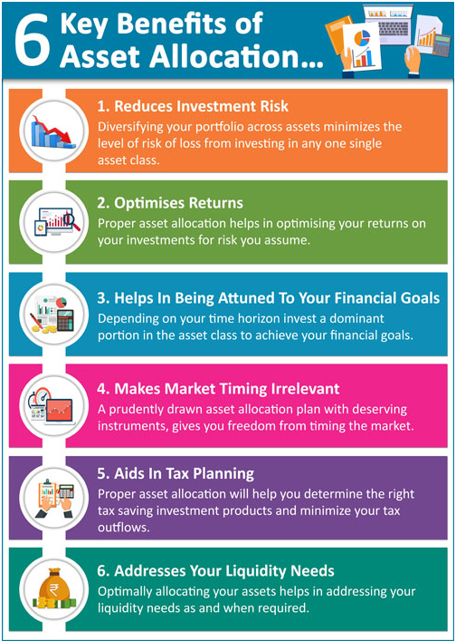

Slide 11
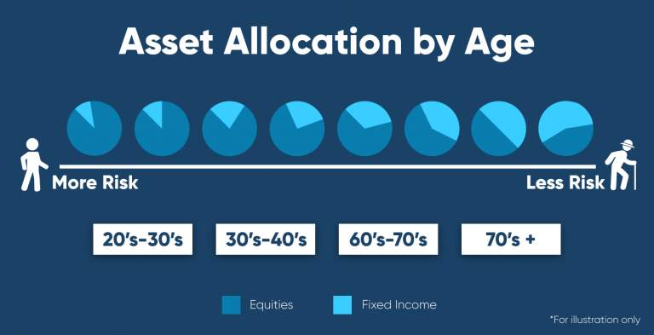
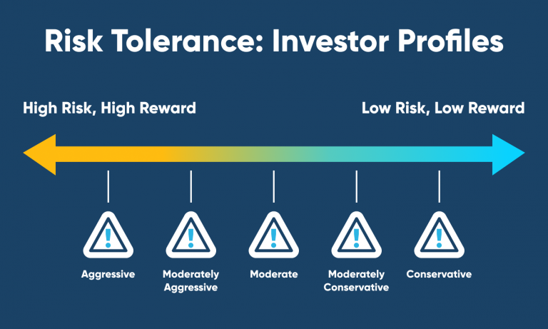

Slide 12
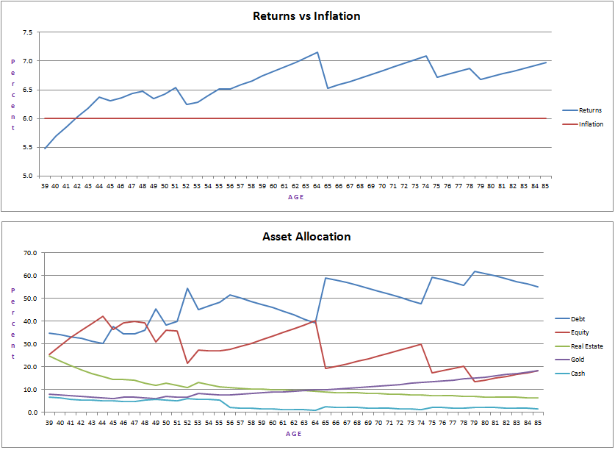
Sample Retirement Plan - Details

Slide 13


THANK YOU
Contact: +91 99205-11283
Website: www.finblueprint.in
Whatsapp Group: Join

